Slide 1
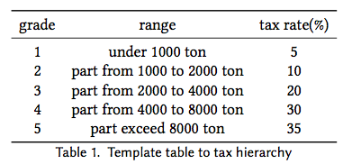
Tax Hierarchy
• order all the materials in the ingredient list
staircase-like structure to distinguish different tax rate

Slide 2
Prevention Mechanism
• Variables in Game Theory
cost of remedial measurement R
cost of regulation C
cost of penalization to the industries F
welfare W
selling price of normal electronics P_{n}
electronics with ingredient list P_{il}
the cost of normal electronics Cn
electronics with ingredient list C_{il}
profit of electronics with ingredient list R_{il} =(P_{il} −C_{il})
profit of electronics without ingredient list Rn =(Pn −Cn)
probability of government taking a regulation α
probability of industry executing the ingredient list β

Slide 3
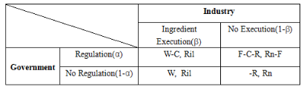
Prevention Mechanism
Expectation
E_{il} =αβ(W−C)+α(1−β)(F−C−R)+(1−α)βW+(1−α)(1−β)R
E_{c} =αβR_{il} +α(1−β)(R_{n} −F)+(1−α)βR_{il} +(1−α)(1−β)R_{n}

Slide 4



Prevention Mechanism
Equilibrium solution for this Game Theory Model
Equilibrium solution for this Game Theory Model
Government is intended to regulation the Industries at the probability of α∗, and the Industry execute Ingredient List at the probability of β∗

